Slide 1

Electromagnetic Coupling to Shielded Cables
F. Rachidi
École Polytechnique Fédérale de Lausanne
EMC Laboratory
Farhad.Rachidi@epfl.ch
http://emc.epfl.ch

Slide 2
Outline
Propagation in coaxial structures
Coupling to coaxial cables: Tramsfer impedance and admittance

Slide 3
Further Details of Propagation on TLs
We have been using the concepts of TEM modes for transmission line models
Let’s review in more depth the derivation of TEM field propagation from a rigorous point of view
Consider a system of ideal conductors (2) and assume that we have an EM field propagating in the z-direction
With a propagation constant γ, such that
A good reference for this material is: Ramo, Whinnery and Van Duzer, “Fields and Waves in Communication Electronics”, John Wiley, 1984.

Slide 4
Propagation on TLs (con’t.)
For this wave-guiding structure, we can categorize the propagating EM fields into 3 classes (or modes)
Modes with E and H components in the transverse plane, and with a component of H in the propagation direction (TE modes)
Modes with E and H components in the transverse plane, and with a component of E in the propagation direction (TM modes)
Modes with E and H components only in the transverse plane (TEM modes)
The TEM modes are the transmission line modes
H_{z}
E & H
E_{z}
H_{z} = E_{z} =0
Keep in mind that a general excitation of these lines may require all 3 mode for a complete solution !

Slide 5
Propagation on TLs (con’t.)
For perfectly conducting structures, these 3 modes can be determined separately
and combined according to the excitation and loading (boundary conditions)
However, for cases involving conductor loss, the modes couple together and are described as hybrid modes
We can derive the properties of these modes from Maxwell’s equations

Slide 6
Propagation on TLs (con’t.)
Starting with Maxwell’s equations in a source-free region (J = 0)
the vector wave equations can be derived:
This is done by taking the curl of the curl-E equation and simplifying:
The same is done for the curl-H equation

Slide 7
Propagation on TLs (con’t.)
Noting the vector identity
the vector wave equations reduce to the vector Helmholtz equation for the E and H fields:
In rectangular coordinates (only) these vector equations separate into the individual scalar equations
With a similar equation for H
This uses the auxiliary relations

Slide 8
Propagation on TLs (con’t.)
The vector Helmholtz equation for can be written as
Assuming that the z-dependence of all field quantities is of the form
we have
Thus, the Helmholtz equations for E and H becomes

Slide 9
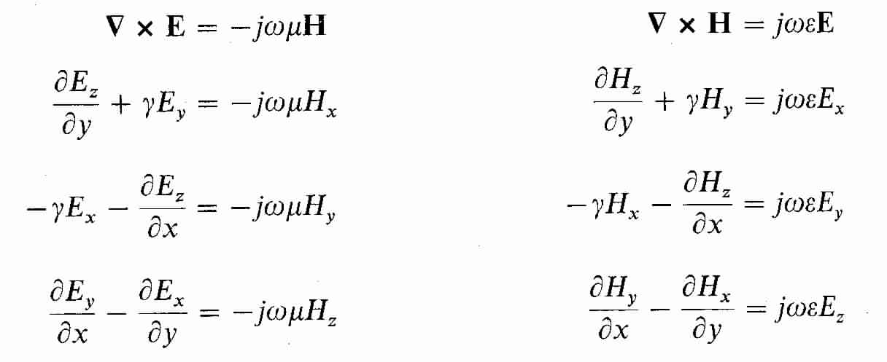
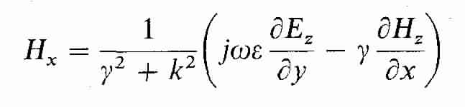
Propagation on TLs (con’t.)
For waves propagating in the +z direction (where all fields have a z dependence of ) the Maxwell curl equations are
From these equations, the transverse E and H field components can be expressed in terms of the longitudinal (z) E and H components
Eliminating E_{y} from these two equations gives an expression for H_{x} in terms of the E_{z} and H_{z} field components.

Slide 10
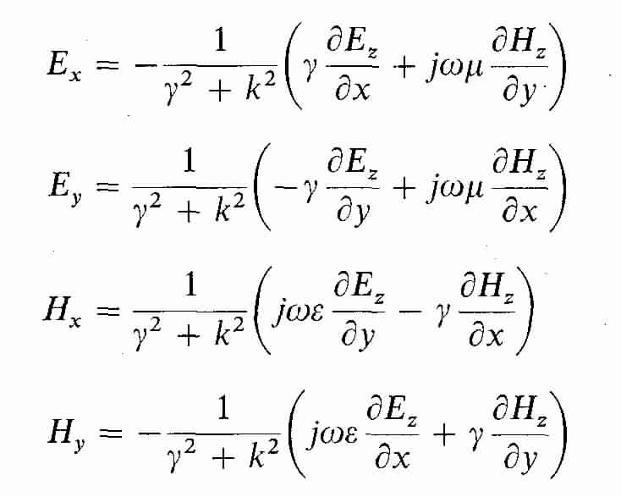
Propagation on TLs (con’t.)
The resulting expressions for the transverse fields are
Where E_{z} and H_{z} are solutions to the scalar Helmholtz equations
These equations must be solved together with the appropriate boundary conditions on the conductors.
k_{c}²

Slide 11
TEM Fields on TLs (con’t.)
TEM fields have E_{z} and H_{z} both equal to zero.
According to the previous expressions for the transverse fields, all fields are zero, unless
In this case, the “wave” equations are
which are Laplace equations for the vector E-field
E and H are in the transverse plane only
We define these as E_{t} and H_{t}

Slide 12
TEM Fields on TLs (con’t.)
Thus, the TEM fields on the line can be described by the expressions
and
The fields E_{t} and H_{t} are related through Maxwell’s equations
Caution
On such a line, the E and H fields are related by the free-space impedance . This is not the same impedance as the characteristic impedance of the transmission line, which is a ratio of the line voltage and current.
0
Similarly, the other component is
Impedance of free-space (377 Ω)

Slide 13
Derivation of the Telegraphers’ Equations
Using the TEM field description, let us now derive the Telegraphers’ equations
Consider a 2-conductor line of arbitrary cross-section:
Since E is a solution to the Laplace equation, we can define the potential as
Differentiating with respect to z gives
From we have

Slide 14
Derivation of the Telegraphers’ Equations (con’t)
Substituting the previous expressions gives
And using the definition of the line inductance (per-unit-length) of the conductors, L´, this expression becomes
Where I is the current flowing in the conductors
Magnetic flux (per-unit-length) flowing between the two conductors
This is the first Telegrapher equation

Slide 15
Derivation of the Telegraphers’ Equations (con’t)
The second Telegraphers’ equation is derived by integrating H-field over path 2:
Taking the derivative in z gives
Using the curl-H equation with E_{z} = 0 gives
Substituting gives
Or by relating the charge to the voltage by the line capacitance we have
This is the total charge (per-unit-length) on the conductor.
This is the second Telegrapher equation

Slide 16
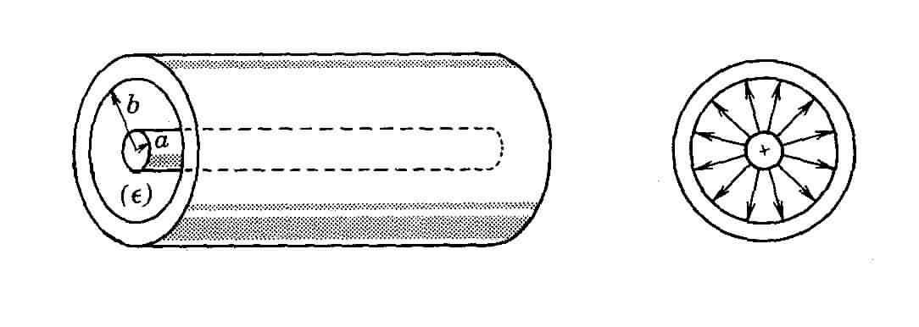
The Coaxial Line
Consider the coaxial line (a “shielded” line)
TEM, TE and TM modes exist
The wave equation for E_{z} (TM) or H_{z} (TE) fields is written in cylindrical coordinates as
ψ denotes either E_{z} or H_{z}
The equation to be solved for ψ(r,φ) is
This equation can be solved by the method of separation of variables

Slide 17
The Coaxial Line (con’t)
The differential equations for g(φ) and f(r) become
Where
The solutions for g(φ) and f(r) are given as
Thus, the total solution for ψ is
k = ω/c
Propagation constant of waves in the z-direction: e ^{±γz}
Bessel functions of integer order

Slide 18
The Coaxial Line (con’t)
The coefficient k_{c} is constrained from the boundary conditions on ψ:
This leads to the following characteristic equations that must be solved for k_{c}
Note that for lossless coaxial lines, k_{c} is real

Slide 19
The Coaxial Line (con’t)
From the definition of
we have the z propagation constant given by
For low frequencies, where ω/c < k_{c} the propagation constant γ is real and the mode propagation in z is attenuated as
For higher frequencies, where ω/c > k_{c} the propagation constant γ is imaginary and the mode propagation in z is
Thus, as long as the frequency is lower than the cutoff frequencies of the TE or TM modes, they are attenuated on the line
Cutoff frequencies are ω _{c} = c k_{c}

Slide 20
TEM Propagation on the Coaxial Line
At low frequencies, the only propagating mode on the line is the TEM mode:
With the following derived relationships for the inductance and capacitance
and propagation constant and transmission line impedance

Slide 21
Losses in the Coaxial Line (con’t)
Low frequency losses in the coaxial line occur in 2 ways:
Dielectric loss – represented by a shunt element G´
Conductor loss – represented by a series element R´
The dielectric loss is usually small for practical cables
It may be calculated using the same form of the equation as for the capacitance
The conductor loss invalidates the TEM assumption
To get around this problem, we assume losses are small, and use a quasi-TEM approximation
Thus, the resulting line model is similar to that previously considered for the 2-conductor line
σ_{d} is the conductivity of the dielectric material in the cable
A longitudinal E-field exists on the conductor surface
Due to the non-zero conductivity of the conductors

Slide 22
Losses in the Coaxial Line (con’t)
General expressions are available for the impedance of a lossy coaxial line at higher frequencies
The per-unit-length “resistance” of the cable is frequency dependent and is complex – it is an impedance
See Schelkunoff’s paper or Vance
Z´_{in} represents an additional voltage drop along the line due to the internal conductor
A similar term is found for the outer conductor
E. F. Vance, “Coupling to Shielded Cables, Krieger Publishing Co, 1987, page 37.

Slide 23
Losses in the Coaxial Line (con’t)
Expressions for the internal impedance of the inner conductor
Define the wave propagation constant in the conducting material (metal)
Z´_{in} is given by
Modified Bessel functions

Slide 24
Losses in the Coaxial Line (con’t)
Expressions for the internal impedance of the outer conductor
Modified Bessel functions

Slide 25
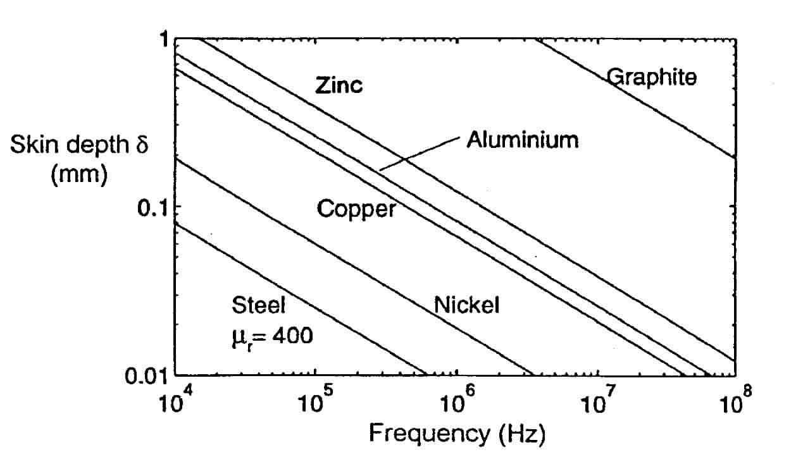
Losses in the Coaxial Line (con’t)
For most EMC applications involving cables, the skin depth in the metal is small compared with the cable radius
The high-frequency expressions for these impedances are applicable

Slide 26
Outline
Propagation in coaxial structures
Coupling to coaxial cables: Transfer impedance and admittance

Slide 27
Coupling to Shielded Cables

Slide 28
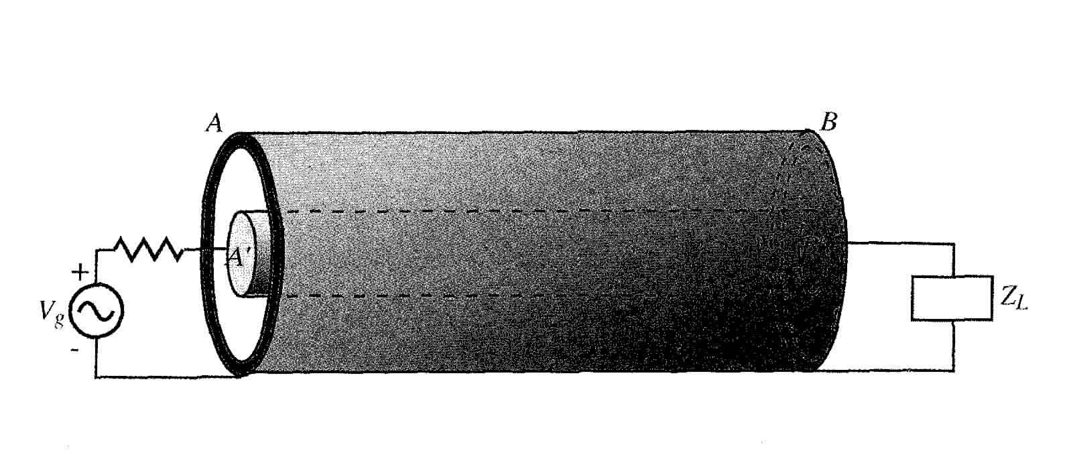
Excitation of a Coaxial Line
A coaxial line can be excited by a voltage or current source at the end of the line
Another type of excitation occurs when an external current produces EM fields that diffuse into the interior, and excite the inner conductor

Slide 29
Excitation of a Coaxial Line (cont’d)
The two-circuit (inside and outside) problem involves coupled solutions to Maxwell’s equations in four (4) regions
This is tedious to solve
However, it is possible to use a good shielding approximation where we assume that the outside problem is not affected by the inside geometry

Slide 30
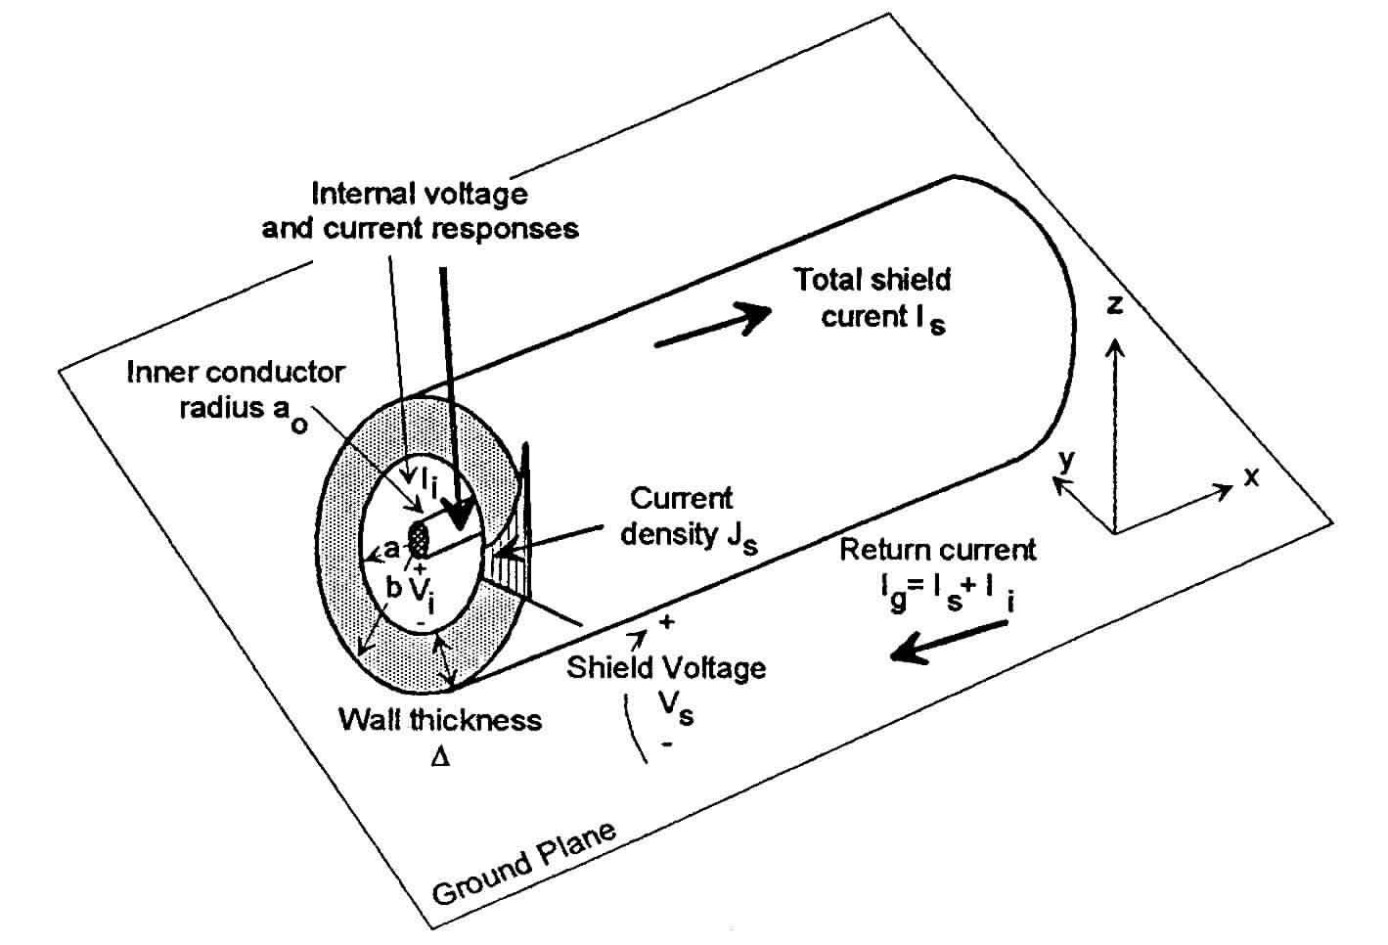
Excitation of a Coaxial Line (cont’d)
Inside the coax, we note that the effect of the external current as it diffuses through the shield is to create a voltage drop along the inside of the shield
This internal voltage drop appears as an excitation voltage source to the internal conductor
External problem computes current and voltage on the outside of the coax, neglecting the internal details
The internal problem is modeled by the per-unit-length transmission line model, together with a distributed voltage source V´_{s}

Slide 31
Excitation of a Coaxial Line (cont’d)
The current flow in the cable sheath will create an axial electric field inside the sheath.
Due to the skin effect, the current distribution and the associated E-field distribution in the sheath cross section are not uniform
E_{i}

Slide 32
Excitation of a Coaxial Line (cont’d)
The internal voltage source V´_{s} arises from the external current I_{external} acting on the conductive shield material
As such, it can be represented by a per-unit-length transfer impedance, Z´_{t} as

Slide 33
The Transfer Impedance
The transfer impedance of a thin tubular shield has been developed by Schelkunoff:
Equals R_{o}, the DC resistance of the shield
Note the exponential decrease of the transfer impedance with shield thickness Δ at high frequencies

Slide 34
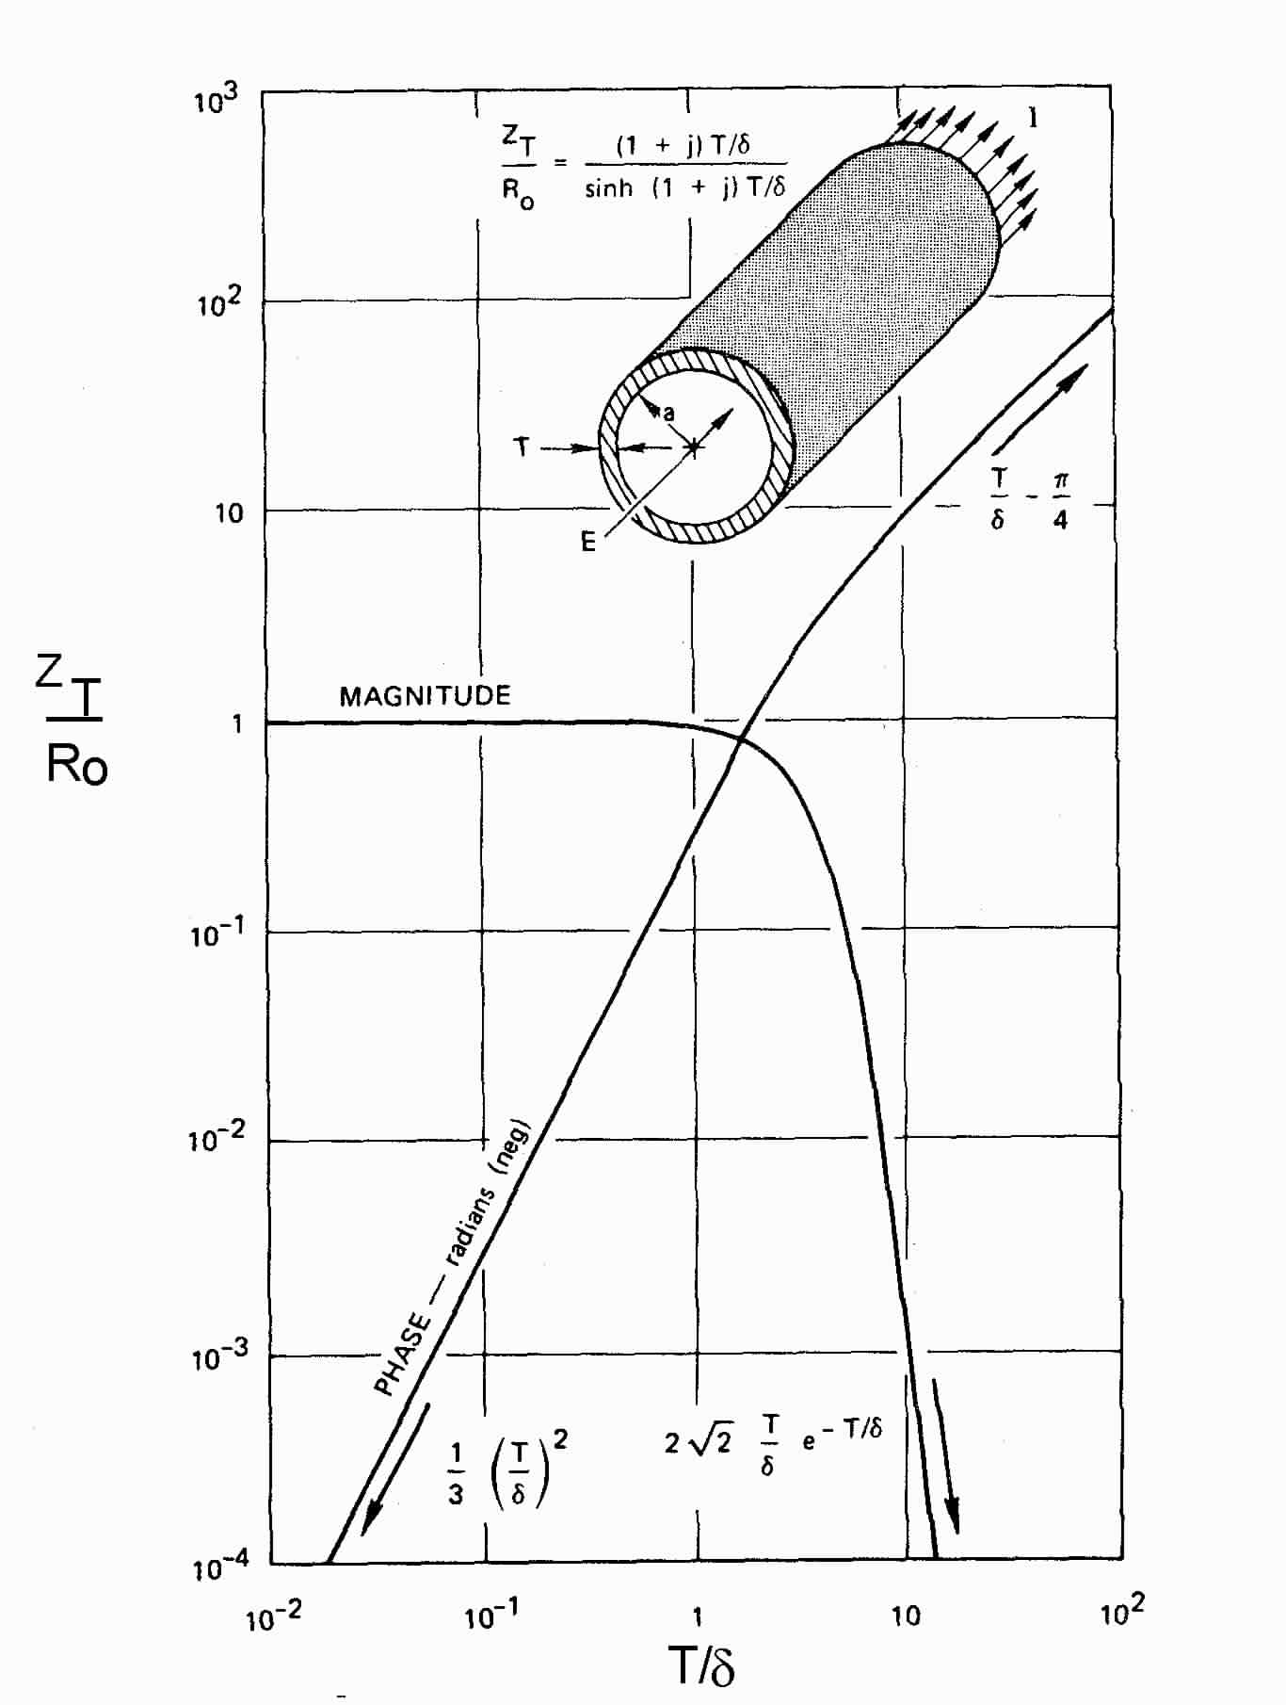
Illustration of the Transfer Impedance
Plot of the calculated Z´_{t}
At DC, the transfer impedance is just the tube resistance
At higher frequencies, it decreases, due to the skin effect.
Magnitude
Phase

Slide 35
Solution for the Internal Responses
The internal line is thus represented by a transmission line with a distributed voltage source excitation
The response of the internal line can be computed by integrating over the source distribution:
See Chapter III on Field-to-Line Coupling.

Slide 36
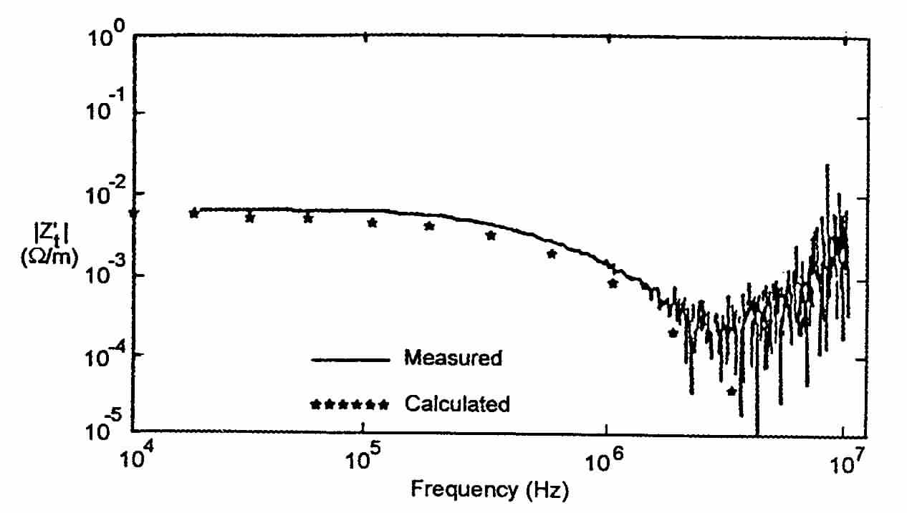
Problems with the Transfer Impedance
As frequencies of operation become higher, we observe that the model for Z´_{t} is inadequate for some shielded cables
This is due to an additional contribution to the transfer impedance that occurs in braided shields
Higher frequency response appears to be growing as ω

Slide 37
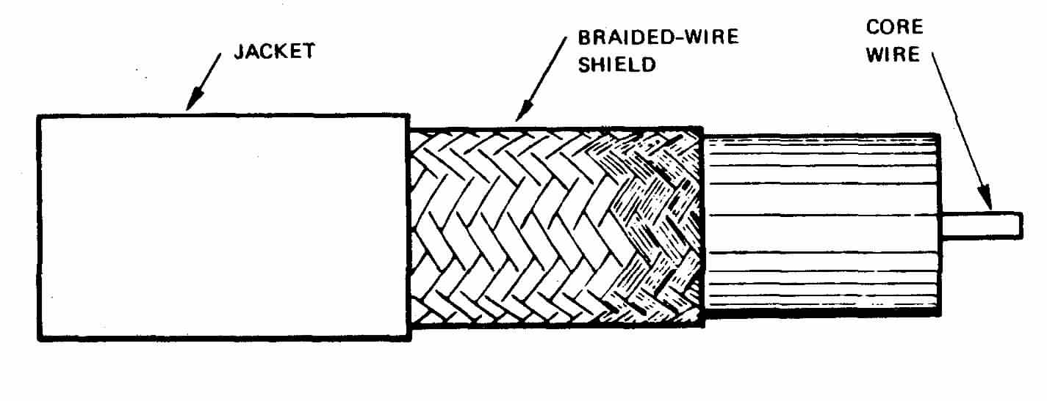
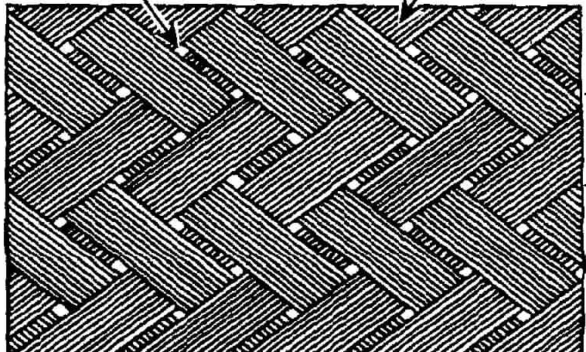
Problems with the Transfer Impedance (cont’d)
The braid is not really a homogeneous shield
It has small openings
The external B-field is able to penetrate inside and the flux introduces an additional component to the transfer impedance
Thus, at high frequencies, the transfer impedance for braided cables can be written as

Slide 38
Determination of the Transfer Impedance
Various models for computing Z’_{t} are available
An alternate (and more accurate) approach is to measure this cable parameter
Measured surface transfer impedance of 1-1/4” diameter copper pipe with a single hole

Slide 39
Improvements in the Shielding Model
For a number of years, the shielding model for braided cables still did not agree well with measurements
Excitation was provided by only 1 field component – the H-field
What was missing was the dual current source excitation – from the external the E-field
This source is not included in the classical formulation of Schelkunoff, but it is present if the shield has holes in it.
I´_{s}(x)

Slide 40
Improvements in the Shielding Model
E-field penetration inside the shield of a coaxial cable through a single aperture

Slide 41
Improvements: The Transfer Admittance
The per-unit-length current source for the internal line is represented by a transfer admittance, Y´_{t}
In this manner, the total internal load response contains two contributions, just like the previous cross-talk calculation
See Chapter III on Field-to-Line Coupling.
For solid coaxial shields, this term is neglected.

Slide 42
Measurements Provide Practical Cable Data
Transfer impedance is specified as
Transfer admittance is
C’_{t} is often specified through the “shield coupling factor”
Internal and external line capacitances

Slide 43
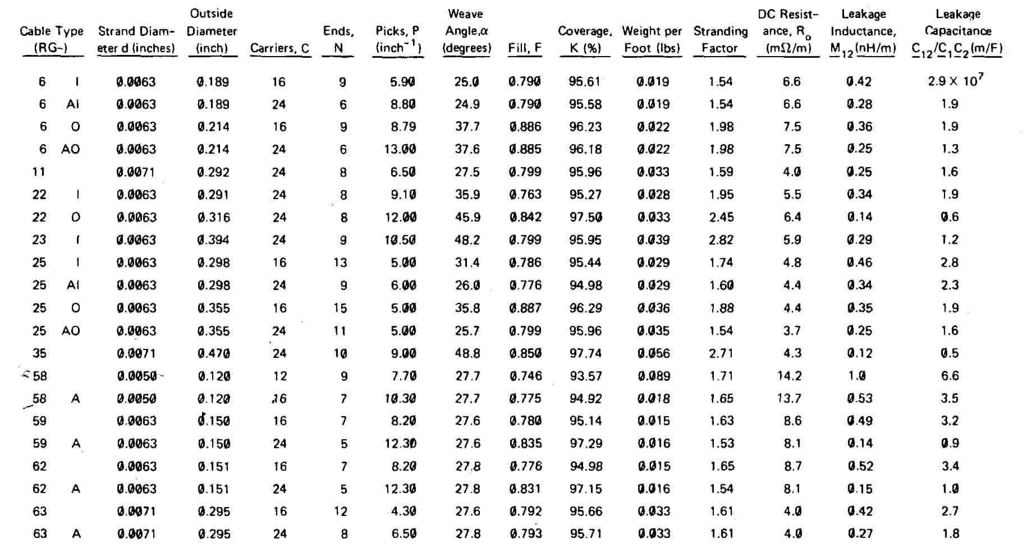
Measurements Provide Practical Cable Data
R_{o}
Δ
M´_{t}
Vance provides computed data for real cables
S´_{t}

Slide 44
Measurements of Transfer Impedance and Admittance
For L << λ:

Slide 45
Measurements of Transfer Impedance and Admittance: Improved Setup
Triaxial Adapted Measurement Setup
Notice that in the triaxial setup, both transmission lines, the external and the internal, are terminated in their characteristic impedances Z_{cs} and Z_{ci} respectively.

Slide 46
Measurements of Transfer Impedance and Admittance: Improved Setup
The current and the voltage in the external line (neglecting the effect of the internal wire) will be given by
Under the condition of an electrically short cable, we can derive the following expressions for the transfer impedance and admittance

Slide 47
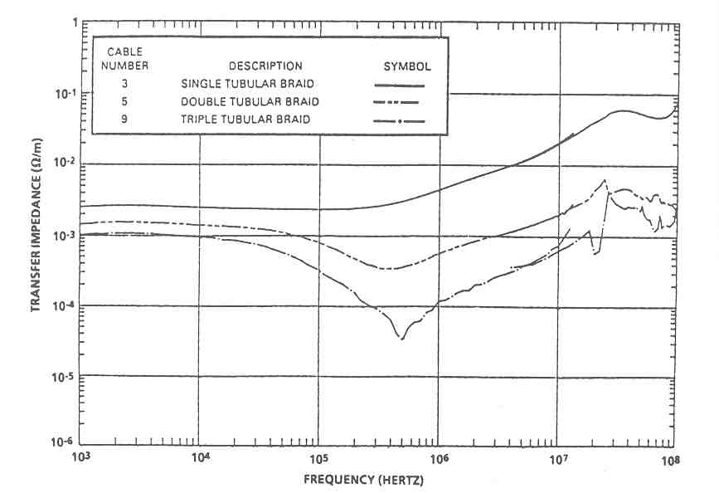
Examples of Measured Transfer Impedance

Slide 48
Numerical Example of the Response of
a Shielded Cable
- RG-58 coaxial cable
- L=30 m, h = 1 m
- σ_{g} = 0.01 S/m and ε_{r} = 10.
- = 100 Ω and = 100 Ω.
Matched internal impedances
( 50 Ω).
- Incident plane wave with
E_{o}=52.5 kV/m, α = 4x106 s⁻¹, β = 4.76x108 s⁻¹.
- Elevation angle ψ=30º , azimuth angle ϕ=0 º, polarisation angle α=0 º.

Slide 49
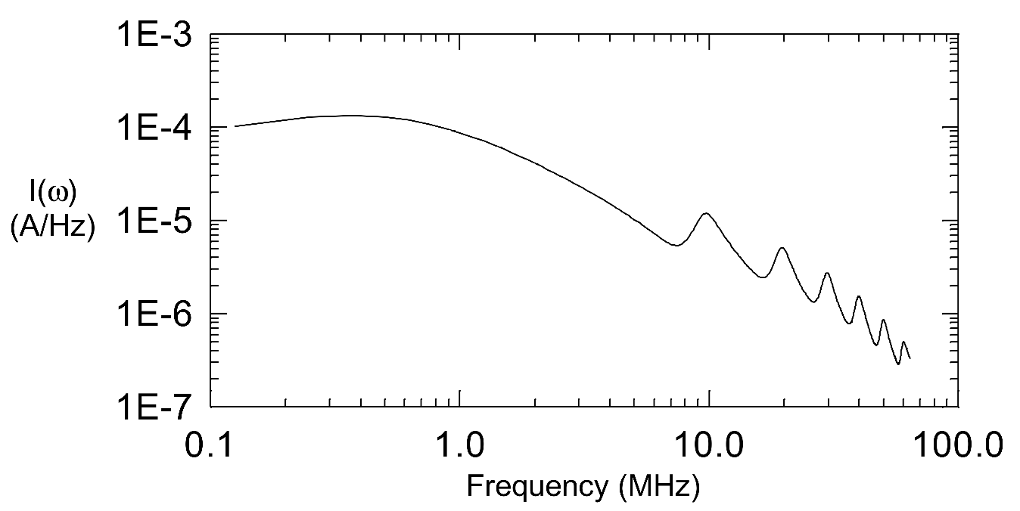
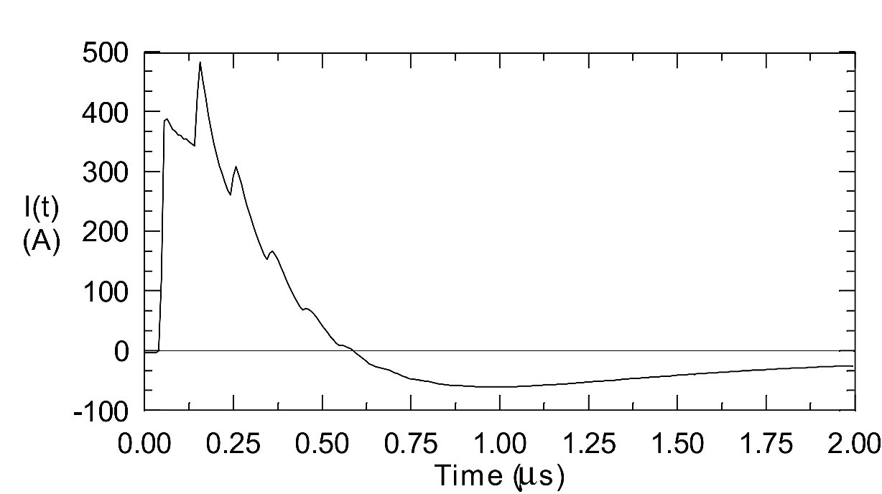
Numerical Example of the Response of
a Shielded Cable: External Response
Spectral magnitude
Transient Response

Slide 50
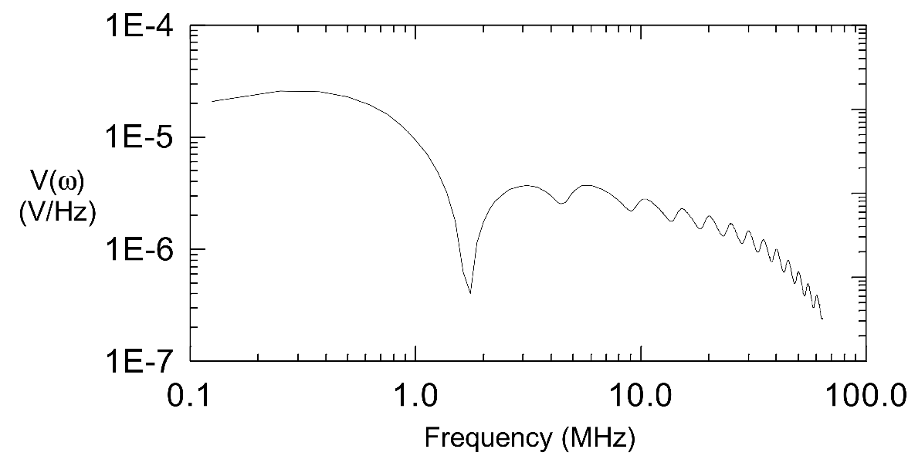
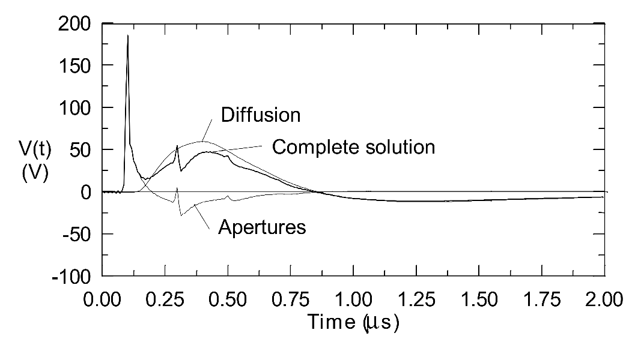
Numerical Example of the Response of
a Shielded Cable: Internal Response
Spectral magnitude
Transient Response

Slide 51
References
[1] F. M. Tesche, Electromagnetic Compatibility, Clemson University.
[2] F. M. Tesche, M. Ianoz, T. Karlsson, EMC analysis methods and computational models. New York: Wiley, 1997.
[3] Ramo, Whinnery and Van Duzer, “Fields and Waves in Communication Electronics”, John Wiley, 1984.
[4] E. F. Vance, Coupling to shielded cables / Edward F. Vance. New York : Wiley, 1978.
[5] B. Démoulin and L. Koné. (2010) Shielded Cables Transfer Impedance Measurement. IEEE EMC Society Newsletter. 38-45.

